Slide 1
Poly Network Hack
A Detailed Case Study of the 2021 Hack

Slide 2

Introduction
This presentation explores the Poly Network hack, examining its background, the attack itself, the involved parties, and the aftermath.

Slide 3
01
What is POLY?

Slide 4
Poly Network Overview
Poly Network is a cross-chain interoperability protocol designed to facilitate asset transfers between multiple blockchains such as Ethereum, BSC, Polygon, Ontology, and HECO. Its primary function is to enable seamless communication and transfer of value across diverse blockchain ecosystems.

Slide 5

Cross-Chain Functionality
The protocol leverages smart contracts deployed on various blockchains to manage cross-chain transactions. This system allows users to easily move assets without going through a centralized exchange, thus enhancing user experience and reducing potential security risks.

Slide 6
Blockchain Integrations
Poly Network integrates multiple blockchain networks, utilizing their unique features to ensure compatibility and efficient asset transfers. By bridging these networks, it aims to strengthen the interconnectedness of decentralized finance and broaden access to digital assets.

Slide 7
02
The Hack

Slide 8
Date of Incident
The hack occurred on August 10, 2021, marking a significant event in the world of decentralized finance as one of the largest cryptocurrency hacks ever recorded.

Slide 9

Total Amount Stolen
The hacker stole over $611 million worth of assets, making this incident remarkable due to the substantial financial impact on the Poly Network and its users.

Slide 10
Funds Across Chains
The funds stolen were distributed across various blockchains, with approximately $273 million from Ethereum, $253 million from Binance Smart Chain, and $85 million from Polygon, highlighting the extensive reach of the attack.

Slide 11
03
Technical Analysis

Slide 12
Vulnerability Explanation
The hack was made possible due to improper access control in Poly Network's smart contracts, specifically within the EthCrossChainData contract. This flaw allowed an unauthorized attacker to manipulate the contract and gain control over significant assets.

Slide 13
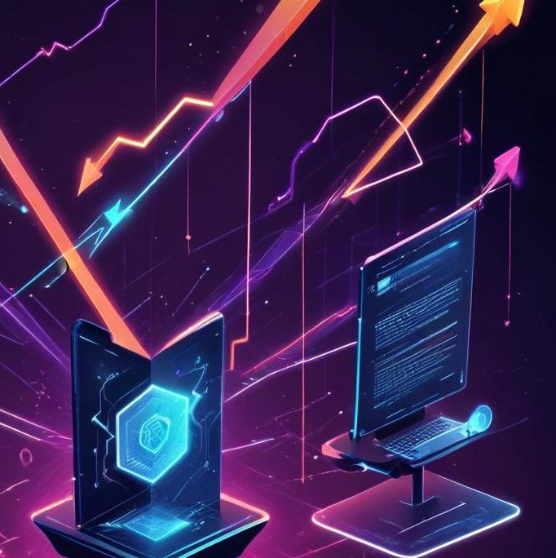
Step-by-Step Attack Process
The attack involved several critical steps: first, the attacker manipulated the EthCrossChainData contract with specially crafted data. Next, they changed the contract's ownership to themselves by altering the keeper or validator addresses. Then, they authorized large withdrawal requests and executed cross-chain transactions to transfer the funds.

Slide 14
Asset Drain Methodology
Once in control, the hacker drained $611 million in assets from various blockchains such as Ethereum, BSC, and Polygon. The method involved exploiting the smart contract's weaknesses to bypass authorization protocols and directly transfer assets to their wallets.

Slide 15
04
Attacker Profile

Slide 16

Hacker's Skills
The attacker exhibited advanced skills in both cross-chain mechanics and smart contract vulnerabilities. Their sophistication indicated a deep understanding of the decentralized finance landscape and the specific technical details of Poly Network.

Slide 17
Communication with Poly Network
Following the hack, the attacker communicated with Poly Network through messages embedded in Ethereum transactions. These messages were critical for negotiating the return of the funds and indicated their intentions.

Slide 18
Motivation Behind the Hack
The hacker claimed that the attack was aimed at exposing vulnerabilities within the system and teaching a lesson, rather than laundering the stolen funds. This unusual motive added complexity to the incident.

Slide 19
05
Aftermath

Slide 20

Return of Stolen Funds
After a public plea from Poly Network, the hacker returned nearly all stolen assets over several days, retaining only $33 million in USDT, which had been frozen by Tether. This return exemplified the unexpected nature of the hacker's actions.

Slide 21
Impact on Poly Network
Although the funds were returned, Poly Network faced reputational damage within the DeFi community. The incident raised serious concerns about the security of cross-chain protocols and the overall trust in decentralized finance.

Slide 22
Legal & Future Implications
Law enforcement agencies, including the FBI, monitored the situation closely. While no arrests were made, this incident underscored the urgency for improved regulations and security standards in the DeFi space.

Slide 23
Conclusions
The Poly Network hack serves as a critical case study highlighting vulnerabilities in decentralized systems. It emphasizes the need for robust security protocols and the importance of ongoing vigilance against emerging threats in the DeFi space.

Slide 24
Thank you!

